Slide 1
Orthogonal Array Testing
Dr. Durga Prasad Mohapatra
Professor
CSE Department
NIT Rourkela

Slide 2
Orthogonal Array Testing
Orthogonal Arrays are two dimensional arrays of numbers that have the attractive feature that
by selecting any two columns in the array, an even distribution of all pairwise combinations of values in the array can be achieved.

Slide 3
Example
In the following table, after selecting first two columns, we get four ordered pairs namely (0,0), (1,1), (0,1) and (1,0).
These pairs form all the possible ordered pairs of two-element set and each ordered pair appears exactly once.

Slide 4

Example
We obtain same values when selecting second and third or first and third column combination. An array exhibiting this feature is known as orthogonal array.

Slide 5
Orthogonal Array Testing
Orthogonal arrays can be used in software testing for pairwise interactions.
It provides uniformly distributed coverage for all variable pairwise combinations.
It is commonly used for integration testing like testing of object-oriented systems, where multiple subclasses can be substituted as the server for a client.

Slide 6
Orthogonal Array Testing
It is a black-box testing technique.
OATS is used when the input to the system to be tested are low,
but if exhaustive testing is used then it is not possible to test completely every input of the system.
100% OATS implies 100% pairwise testing.
OATS can be used for testing combinations of configurable options like a webpage that allows the other user to select:

Slide 7
Configurable options - Example
Font style;
Font color;
Back ground Color;
Page layout;
Etc.

Slide 8
Steps to use OATS
Step 1: Identify the independent variables that are to be used for interaction. These will be mapped as “factor” (f) of array.
Step 2: Identify the maximum number of values, which each variable will take. These will be mapped as “levels” (p) of the array.
Step 3: Search for an orthogonal array that has all factors from Step 1 and all levels from Step 2.

Slide 9
Steps to use OATS
Step 4: Map all the factors and levels with your requirements.
Translate them into suitable test cases.
Look out for any special test cases.
If we have 3 variables (parameters) that have 3 values, then the possible number of test cases using conventional technique is 3*3*3=27. But, if OATS is used, then the number of test cases will be 9.

Slide 10
Example 1
Consider a scenario in which we need to derive test cases for a web page of a research paper that has four different sections:
(a) Abstract
(b) Related work
(c) Proposed work
(d) Conclusion

Slide 11
Example 1
The four sections can be individually shown or hidden to the user or show error message. Thus it is required to design the test condition to test interaction between different sections.

Slide 12
Solution
Step 1: Number of independent variables or factors = 4.
Step 2: Value that each independent variable can take = 3 values (shown, hidden or error message).
Step 3: Orthogonal array would be 3² .
Step 4: The appropriate orthogonal array for 4 factors and 3 levels is shown in the table.

Slide 13
Solution
Experiment No. | Factor A | Factor B | Factor C | Factor D
1 | 1 | 1 | 1 | 1
2 | 1 | 2 | 2 | 2
3 | 1 | 3 | 3 | 3
4 | 2 | 1 | 2 | 3
5 | 2 | 2 | 3 | 1
6 | 2 | 3 | 1 | 2
7 | 3 | 1 | 3 | 2
8 | 3 | 2 | 1 | 3
9 | 3 | 3 | 2 | 1

Slide 14
Solution
Step 5: Now, map the table with our requirements.
1 will represent “Shown” value.
2 will represent “Hidden” value.
3 will represent “Error Message” value.
Factor A will represent “Abstract” section.
Factor B will represent “Related Work” section.
Factor C will represent “Proposed Work” section.

Slide 15
Solution
Factor D will represent “Conclusion” section.
Experiment will represent “Test Case #”.
Step 6: After mapping, the table will look like:

Slide 16
Solution
Test Case | Abstract | Related Work | Proposed work | Conclusion
Test Case 1 | Shown | Shown | Shown | Shown
Test Case 2 | Shown | Hidden | Hidden | Hidden
Test Case 3 | Shown | Error Message | Error Message | Error Message
Test Case 4 | Hidden | Shown | Hidden | Error Message
Test Case 5 | Hidden | Hidden | Error Message | Shown
Test Case 6 | Hidden | Error Message | Shown | Hidden
Test Case 7 | Error Message | Shown | Error Message | Hidden
Test Case 8 | Error Message | Hidden | Shown | Error Message
Test Case 9 | Error Message | Error Message | Hidden | Shown

Slide 17
Positive Testing
Positive testing tries to prove that a given product does what it is supposed to do.
Positive Testing is testing process where the system is validated against the valid input data.
In this testing tester always check for only valid set of values and check if an application behaves as expected with its expected inputs.

Slide 18
Positive Testing cont …
The main intention of this testing is to check whether software application not showing error when not supposed to and showing error when supposed to.
Such testing is to be carried out keeping positive point of view and only execute the positive scenario.
When a test case verifies the requirements of the product with a set of expected output, it is called positive test case.

Slide 19
Positive Testing cont …
The purpose of positive testing is to prove that the product works as per specification and expectations.
A product delivering an error when it is expected to give an error, is also a part of positive testing.
Positive testing can thus be said to check the product’s behaviour for positive and negative conditions as stated in the requirement.

Slide 20
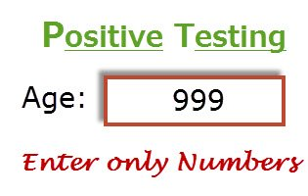
Example of Positive testing
Consider a scenario where you want to test an application which contains a simple textbox to enter age and requirements say that it should take only integer values.
So here provide only positive integer values to check whether it is working as expected or not is the Positive Testing.
Most of the applications developers implement Positive scenarios where testers get less defects count around positive testing.

Slide 21
Another example
Let us take a lock and key. We do not know how the levers in the lock work, but we only know the set of inputs (the number of keys, specific sequence of using the keys and the direction of turn of each key) and the expected outcome (locking and unlocking). For example, if a key is turned clockwise it should unlock and if turned anticlockwise it should lock.
To use the lock one need not understand how they work. However, it is essential to know the external functionality of the lock and key system. Some of the functionality that you need to know to use the lock are given as follows.

Slide 22
Some functionalities to use the lock
Functionality | What you need to know to use
Features of a lock | It is made of metal, has a hole provision to lock, has a facility to insert the key and the keyhole ability to turn clockwise or anticlockwise.
Features of key | It is made of metal and created to fit into a particular lock’s keyhole.
Actions performed | Key inserted and turned clockwise to unlock. Key inserted and turned anticlockwise to lock.
States Inputs Expected outcome | Locked. Unlocked. Key turned clockwise or anticlockwise. Locking. Unlocking.

Slide 23
Sample requirements specification for lock and key system
Sl. No. | Requirements identifier | Description | Priority (High, med, low)
1 | BR-01 | Inserting the key numbered 123-456 and turning it clockwise should facilitate locking | H
2 | BR-02 | Inserting the key numbered 123-456 and turning it anticlockwise should facilitate unlocking | H
3 | BR-03 | Only key number 123-456 can be used to lock and unlock | H
4 | BR-04 | No other object can be used to lock | M
5 | BR-05 | No other object can be used to unlock | M
6 | BR-06 | The lock must not open even when it is hit with a heavy object | M
7 | BR-07 | The lock and key must be made of metal and must weigh approximately 150 grams | L
8 | BR-08 | Lock and unlock directions should be changeable for usability of left-handers | L

Slide 24
Example of positive test cases
Test Case id | Req. No. | Input 1 | Input 2 | Current state | Expected output
TC 1 | BR-01 | Key 123-456 | Turn clockwise | Unlocked | Locked
TC 2 | BR-01 | Key 123-456 | Turn clockwise | Locked | No change
TC 3 | BR-02 | Key 123-456 | Turn anticlockwise | Unlocked | No change
TC 4 | BR-02 | Key 123-456 | Turn anticlockwise | Locked | Unlock
TC 5 | BR-04 | Hairpin | Turn clockwise | Locked | No change

Slide 25
Example of positive test condition for positive testing
Take the first row in the table.
When the lock is in an unlocked state and you use key 123-456 and turn it clockwise, the expected outcome is to get it locked.
During test execution, if the test results in locking, then the test is passed.

Slide 26
Example of negative test condition for positive testing
In the fifth row of the table, the lock is in locked state.
Using a hairpin and turning it clockwise should not cause a change in state or cause any damage to the lock.
On test execution, if there are no changes, then this positive test case is passed.

Slide 27
Negative Testing
Negative testing is done to show that the product does not fail when an unexpected input is given.
The purpose of negative testing is to try and break the system.
Negative testing covers scenarios for which the product is not designed and coded.

Slide 28
Negative Testing cont …
In other words, the input values may not have been represented in the specification of the product.
These test conditions can be termed as unknown conditions for the product as far as the specifications are concerned.
But, at the end-user level, there are multiple scenarios that are encountered and that need to be taken care of by the product.

Slide 29
Negative Testing cont …
It becomes even more important for the tester to know the negative situations that may occur at the end-user level so that the application can be tested and made fool proof.
A negative test would be a product not delivering an error when it should or delivering an error when it should not.

Slide 30
Negative Testing cont …
Negative Testing is testing process where the system is validated against the invalid input data.
A negative test checks if an application behaves as expected with its negative inputs.
The main intention of this testing is to check whether software application not showing error when supposed to and showing error when not supposed to.

Slide 31
Negative Testing cont …
Such testing is to be carried out keeping negative point of view and only execute the test cases for only invalid set of input data.
Negative testing is a testing process to identify the inputs where system is not designed or un-handled inputs by providing different invalid inputs.

Slide 32
Negative Testing cont …
The main reason behind Negative testing is to check the stability of the software application against the influences of different variety of incorrect validation data set.
The Negative testing helps to improve the testing coverage of your software application under test.
Both positive and negative testing approaches are equally important for making your application more reliable and stable.

Slide 33
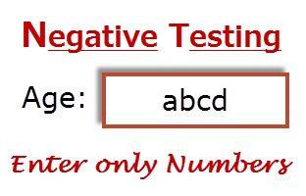
Example of Negative Testing
Consider a textbox example which should accept only integer values.
So here provide the characters like “abcd” in the age textbox and check the behavior of application, either it should show a validation error message for all invalid inputs (for all other than integer values) or system should not allow to enter a non integer values.

Slide 34
Example of negative test cases
Test Case id | Input 1 | Input 2 | Current state | Expected output
1 | Some other lock’s key | Turn clockwise | Lock | Lock
2 | Some other lock’s key | Turn anticlockwise | Unlock | Unlock
3 | Thin piece of wire | Turn anticlockwise | Unlock | Unlock
4 | Hit with a stone |  | Lock | Lock
In the above table, there are no requirement numbers, this is because negative testing focuses on test conditions that lie outside the specification.
Since all the test conditions are outside the specification, they cannot be categorized as positive and negative test conditions.
Some people consider all of them as negative test conditions, which is technically correct.

Slide 35
Positive and negative testing scenarios
If the requirement is saying that password text field should accepts 6 – 20 characters and only alphanumeric characters.
Positive Test Scenarios
Password textbox should accept 6 characters
Password textbox should up to 20 characters
Password textbox should accepts any value in between 6-20 chars length.
Password textbox should accepts all numeric and alphabets values.
Negative Test scenarios
Password textbox should not accept less than 6 characters
Password textbox should not exceeds more than 20 characters
Password textbox should not accept special characters

Slide 36
Positive and Negative Test Scenarios with Example
Suppose, you are doing the testing on a login form which has following fields like Username, Password, and Sign In, Sign Up, Cancel, Login Button etc.
Now positive scenario of login form is that you enter the valid username and password in the username and password field, and then click on Login Button to check whether the user is able to login or not.
Negative scenario of login form is that you leave the password field blank and fill the username field, and then click on Login Button to check whether the user is able to login or not.

Slide 37
Consideration for both the testing
In both the testing, following needs to be considered:
Input data
Action which needs to be performed
Output Result

Slide 38
Testing Technique used for Positive and Negative Testing
Following techniques are used for Positive and negative validation of testing:
Boundary Value Analysis
Equivalence Partitioning

Slide 39
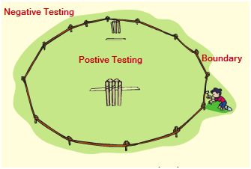
Boundary Value Analysis
This is one of the software testing technique in which the test cases are designed to include values at the boundary.
If the input data is used within the boundary value limits, then it is said to be Positive Testing.
If the input data is picked outside the boundary value limits, then it is said to be Negative Testing.

Slide 40
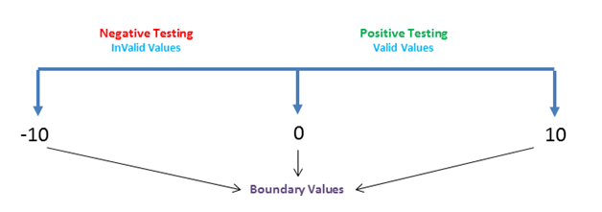
Example
A system can accept the numbers from 0 to 10 numeric values.
All other numbers are invalid values.
Under this technique , boundary values 0 , 10 and -10 will be tested.

Slide 41
Equivalence Partitioning
This is a software testing technique which divides the input data into many partitions.
Values from each partition must be tested at least once.
Partitions with valid values are used for Positive Testing.
While partitions with invalid values are used for negative testing.

Slide 42
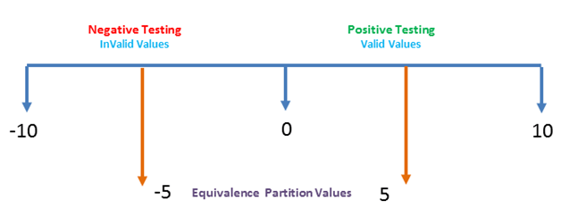
Example
Numeric values Zero to ten can be divided to two( or three )partition.
In our case we have two partitions -10 to -1 and 0 to 10.
Sample values (5 and -5) can be taken from each part to test the scenarios.

Slide 43

Difference between positive and negative testing
For positive testing if all documented requirements and test conditions are covered, then coverage can be considered to be 100 percent.
If the specifications are very clear, then coverage can be achieved.
In contrast, there is no end to negative testing and 100 percent coverage in negative testing is impractical.
Negative testing requires a high degree of creativity among the testers to cover as many “unknowns” as possible to avoid failure at a customer site.

Slide 44
Top Distinctions between Positive & Negative Testing
Positive Testing (Valid) | Negative Testing (Invalid)
1. Positive Testing means testing the application or system by giving valid data. | 1. Negative Testing means testing the application or system by giving invalid data.
2. In this testing tester always check for only valid set of values. | 2. In this testing tester always check for only invalid set of values.
3. Positive Testing is done by keeping positive point of view for example checking the mobile number field by giving numbers only like 9999999999. | 3. Negative Testing is done by keeping negative point of view for example checking the mobile number field by giving numbers and alphabets like 99999abcde.
4. It is always done to verify the known set of Test Conditions. | 4. It is always done to break the project and product with unknown set of Test Conditions.
5. This Testing checks how the product and project behave by providing valid set of data. | 5. This Testing covers those scenarios for which the product is not designed and coded by providing invalid set of data.
6. Main aim means purpose of this Testing is to prove that the project and product works as per the requirements and specifications. | 6. Main aim means purpose of this Testing is try to break the application or system by providing invalid set of data.
7. This type of Testing always tries to prove that a given product and project always meets the requirements and specifications of a client and customer. | 7. Negative Testing is that in which tester attempts to prove that the given product and project does, which is not said in the client and customer requirements.

Slide 45
ERROR GUESSING
Error guessing is the preferred method used when all other methods fail.
Sometimes error guessing is used to test some special cases.
Error guessing is a very practical case wherein the tester uses his intuition, experience, knowledge of project, bug history and makes a guess about where the bug can be.
Basic idea is to make a list of possible errors in error prone situations and then develop the test cases.
No general procedure for this tech exists. It is an adhoc process.

Slide 46
Example - Special cases in the roots of a quadratic equation
What will happen when a=0 in the quadratic equation?
- Though, we do consider this case,
there are chances that we may overlook it while testing, as it has two cases:
i) If a=0 then the equation is no longer quadratic.
ii) For calculation of roots, the division is by zero. So, we may overlook.

Slide 47
What will happen when all the inputs are negative?
What will happen when the inputs list is empty?

Slide 48
Summary
Discussed Orthogonal Array Testing.
Explained Positive and Negative Testing with suitable examples.
Presented Error Guessing.

Slide 49
References
Naresh Chauhan, Software Testing: Principles and Practices, (Chapter – 4), Second Edition, Oxford University Press, 2016.

Slide 50
Thank you

